Slide 1
Internet Video Tutorial
Hui Zhang
Vyas Sekar
Ion Stoica

Slide 2
Tutorial Overview
Past, present, and future of Internet video from both industry and research perspective
Industry vs research evolution/disconnect/synergy
Industry:
Evolution of Internet video ecosystem in last 20 years
Evolution of key technologies in last 20 years
Drivers for future evolution
Research:
Research focus prior to growth of Internet video industry
Latest research works responding to and enabled by changing industry landscape and application scenario’s
New research directions to address future challenges

Slide 3
Tutorial Outline
Part 1: evolution of Internet video ecosystem
Part 2: latest research on relationship between user engagement and video quality
Enabling new data source: detailed & comprehensive client-side measurement
Data analysis techniques useful in this context
Part 3: latest research on improving video quality
New problem formulations in the context of today’s Internet video ecosystem
Part 4: future directions
Drivers for future changes in Internet video ecosystem
Drivers and opportunities for future research

Slide 4
Part 1: Evolution of Internet Video Ecosystem

Slide 5
Part 1 Outline
Three periods of Internet video evolution
Evolution of video delivery protocols
Today’s end-to-end video eco-system

Slide 6
Part 1 Outline
Three periods of Internet video evolution
1992 – 2004
2005 – 2010
2010 -
Evolution of video delivery protocols
Today’s end-to-end video eco-system

Slide 7
Research Efforts in 1990s
Quality of Service support inside network
Packet scheduling algorithms
Reservation protocols
Intserv, Diffserv
IP Multicast
Layered coding
Adaptive applications
Programming model for multi-media applications

Slide 8
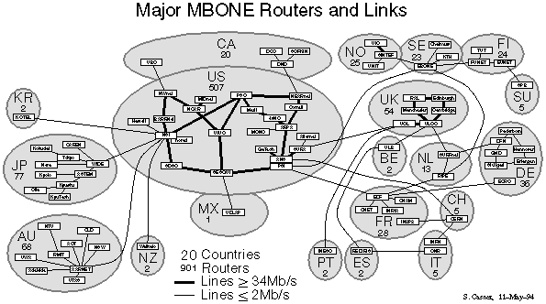

… and Multi-party Conferencing Was The Motivating Application …

Slide 9
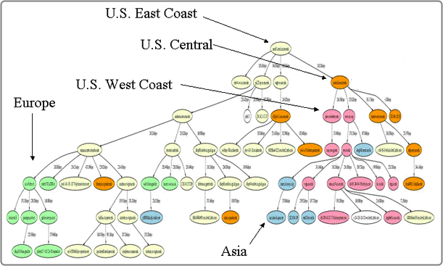
Video Research in Early 2000s
Peer to Peer
End System Multicast
Bit torrent
Coolstreaming, PPLive

Slide 10


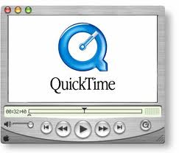

1990 – 2004: 1st Generation Commercial PC/Packet Video Technologies
Simple video playback, no support for rich app
Not well integrated with Web browser
Proprietary protocols, servers, and streamers
No critical mass of compelling content over Internet
Not enough broadband penetration

Slide 11


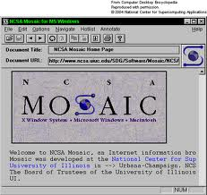




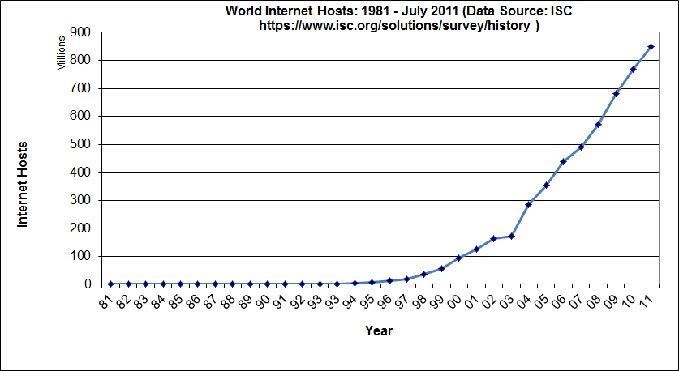
Internet Growth 1994 – 2004:
Web Internet … Not the Video Internet
Notes:
Even though there exist several techniques, the internet was just a Web Internet.

Slide 12
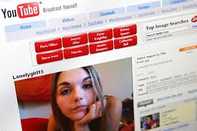

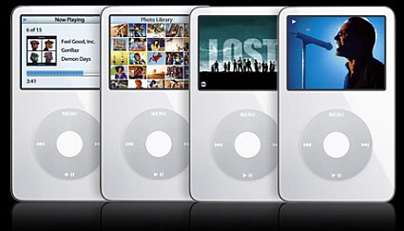
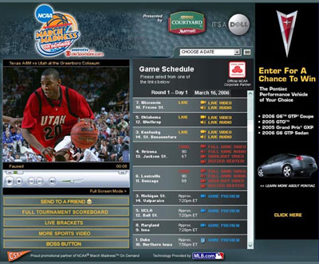
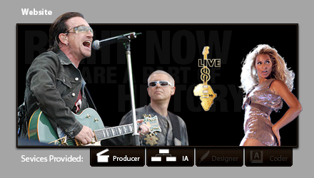
2005: Beginning of Internet/Web Video Era
100M streams first year
Premium Sports Webcast on Line

Slide 13
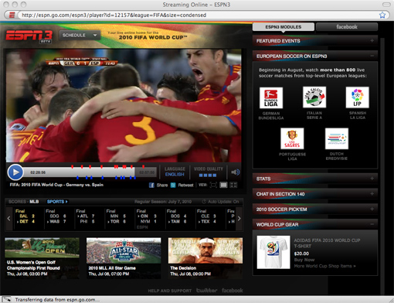

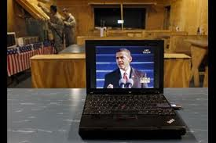

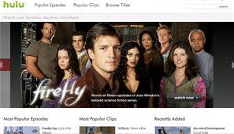
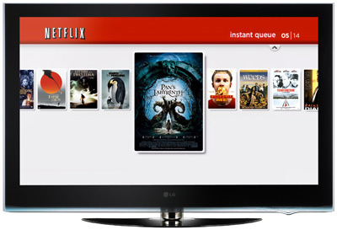



2006 – 2011: Internet Video Going Prime Time
2006
2007
2008
2009
2010
2011

Slide 14

Flash: Enabling Technology For Phase 2 Growth 2005-2011
Client-side: Flash being the de-facto platform
Works in all browsers
Works across OSes
RTMP being the protocol
Maturing CDN technologies to support streaming

Slide 15
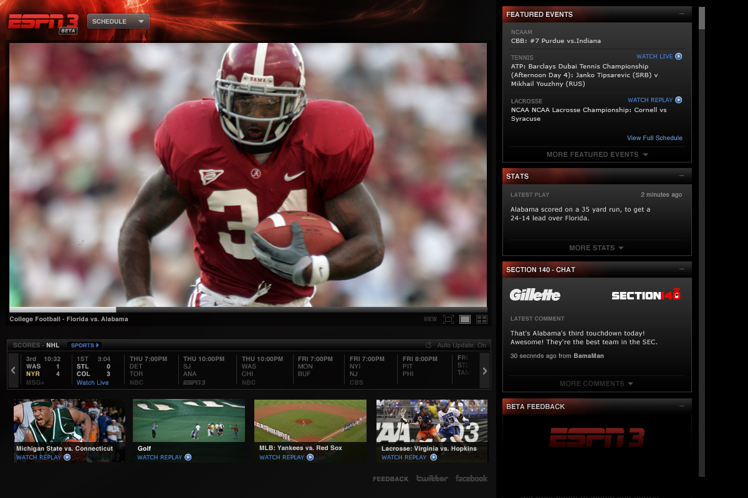
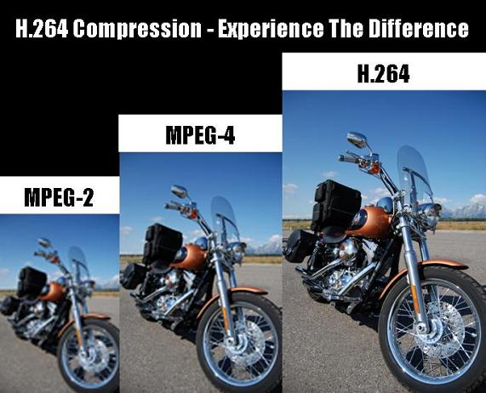
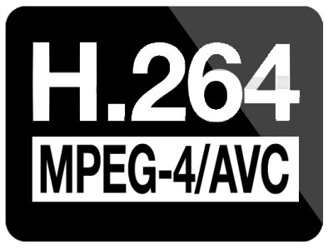
What is Flash?
Browser plugin developed by Macromedia (acquired by Adobe in 2005)
A programming environment that is independent of browser types and OSes
Rich interactive features and seamless browser integration ➔ desktop application-like features
Flash Player 9.0 + ActionScript 3.0 introduced in 2006 brought a new virtual machine and a just-in-time compiler with 10x performance improvements enabling a wave of more sophisticated and interactive video and web applications
Support for video
Rendering, decoding, introduced H.264 in 2007
Streaming (RTMP),
Content protection (RTMPE, tokenization)
More than 95% penetration on PCs

Slide 16
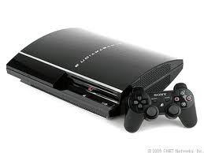

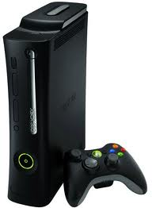



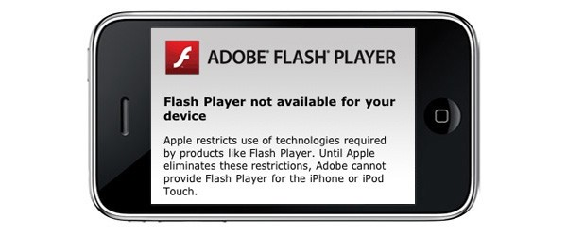
2010: Apps and Multi-Devices
Rise of apps and the slow decline of Flash as the universal video platform
iPhone was launched on June 29th, 2007 without support for Flash
iPad was launched on April 3rd, 2010 also without support for Flash
Adobe announced removing support for Flash on Android on June 27th, 2012 (almost exactly 5 years after iPhone launched)

Slide 17
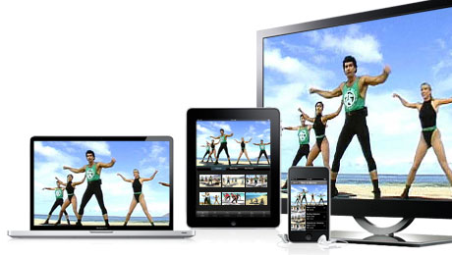
2011 – Present
Four separate screens
PC
Phone
Tablet
TV: connected directly to Internet or via other devices (e.g. Roku, Xbox, PlayStation, AppleTV)
Different user behaviors and video applications for different screens
Fragmented playback software environment
Apps on mobile and tablet devices (iOS, Android)
Apps on game consoles and connected TVs (Xbox, PS3, Roku, AppleTV, Samsung TV, LG TV, etc.)
Both Flash and Silverlight on PCs

Slide 18
Part 1 Outline
Three periods of Internet video evolution
Evolution of video delivery protocols
Today’s end-to-end video eco-system

Slide 19
Internet Video Requirements
Smooth/continuous playback
Elasticity to startup delay: need to think in terms of RTTs
Elasticity to throughput
Multiple encodings: 200Kbps, 1Mbps, 2 Mbps, 6 Mbps, 30Mbps
Multiple classes of applications with different requirements
 | Delay | Bandwidth | Examples
2, N-way conference | < 200 ms | 4 kbps audio only, 200 kbps – 5 Mbps video | Skype, Google hangout, Polycom, Cisco
Short form VoD | < 1-5s | 300 kbps – 2 Mbps & higher | Youtube
Long form VoD | < 5-30s | 500 kbps – 6 Mbps & higher | Netflix, Hulu, Qiyi, HBOGO
Live Broadcast | < 5-10s | 500 kbps – 6 Mbps & higher | WatchESPN, MLB
Linear Channel | < 60s | 500 kbps – 6 Mbps & higher | DirectTV Live

Slide 20
Playout Buffer, Delay, Smooth Playback
Max Buffer Duration
= allowable jitter
File Position
"Bad": Buffer overrflows
Smooth Playback Time
Max Buffer Size
Buffer Duration
"Bad": Buffer underflows and playback stops
Buffer Size
"Good" Region: smooth playback
Buffer almost empty
Time

Slide 21
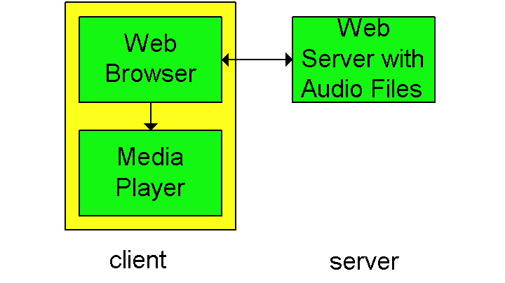
First Generation: HTTP Download
A simple architecture is to have the Browser request the object(s) and after their reception pass them to the player for display
No pipelining

Slide 22
First Gen: HTTP Progressive Download (2)
Alternative: set up connection between server and player; player takes over
Web browser requests and receives a Meta File (a file describing the object) instead of receiving the file itself;
Browser launches the appropriate Player and passes it the Meta File;
Player sets up a TCP connection with Web Server and downloads or streams the file

Slide 23
Drawbacks of HTTP Progressive Download
Data flows as fast as possible to user's local buffer
May download lots of extra data if you do not watch the video
TCP file transfer can use more bandwidth than necessary
Mismatch between whole file transfer and stop/start/seek playback controls.
However: use file range requests to seek to video position
Cannot change video quality (bit rate) to adapt to network congestion

Slide 24
2nd Generation: Stateful Session-based Proprietary Streaming Protocols
Separate control & data connections for the session
Control connection: start, rewind, fast forward, pause
Data connection: either TCP or UDP (not HTTP)
Stateful server keeps session state
Examples: RTSP, RTMP

Slide 25
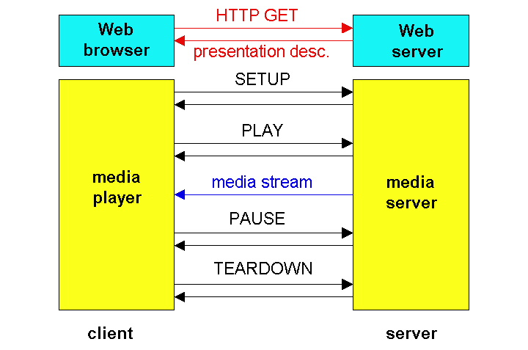
RTSP Operation

Slide 26
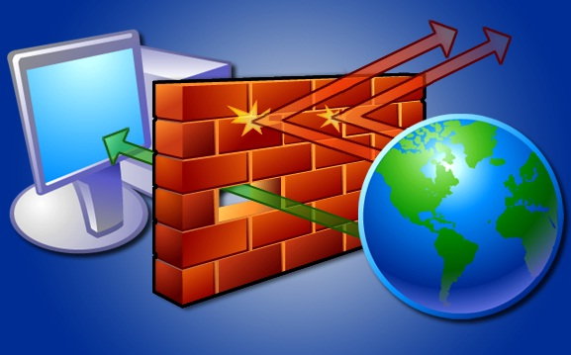
Issues with RTSP, RTMP
Web servers ride on higher performance/price curve than specialized streaming servers
Security concerns resulting in blocking of UDP or TCP with non-standard port numbers

Slide 27
3rd Generation: HTTP Streaming
Key observations: rather than adapt Internet to streaming, adapt media delivery to the Internet
Other terms for similar concepts: Adaptive Streaming, Smooth Streaming, HTTP Chunking
Client-centric architecture with stateful client and stateless server
Standard server: Web servers
Standard Protocol: HTTP
Session state and logic maintained at client
Video is broken into multiple chunks
Chunks begin with keyframe so independent of other chunks
A series of HTTP progressive downloads of chunks
Playing chunks in sequence gives seamless video

Slide 28
Adaptive Multi-Bit Rate with HTTP Streaming
Encode video at different levels of quality/bandwidth
Client can adapt to different bit rates within a single session by requesting different sized chunks
Chunks of different bit rates must be synchronized
All encodings have the same chunk boundaries and all chunks start with key frames, so you can make smooth splices to chunks of higher or lower bit rates

Slide 29
HTTP Chunking Protocol
Server
Client
HTTP Adaptive Player
B1
A1
A2
…
…
A1
A1
A1
A2
B1
B2
…
…
HTTP GET A1
B2
HTTP GET B2
Cache
B1
B2
Web browser
Web server
Web server
HTTP
HTTP
TCP
TCP

Slide 30
Reasons for Wide Adoption
Client-driven control enables server/CDN switch
CDN Infrastructure
Client
HTTP Adaptive Player
B1
A1
A2
…
…
A1
A1
A2
B1
B2
…
…
Cache
B1
B2
Web browser
Web server
Web server
HTTP
HTTP
TCP
TCP
Middlebox/firewall penetration
Reuse the CDN infrastructure

Slide 31
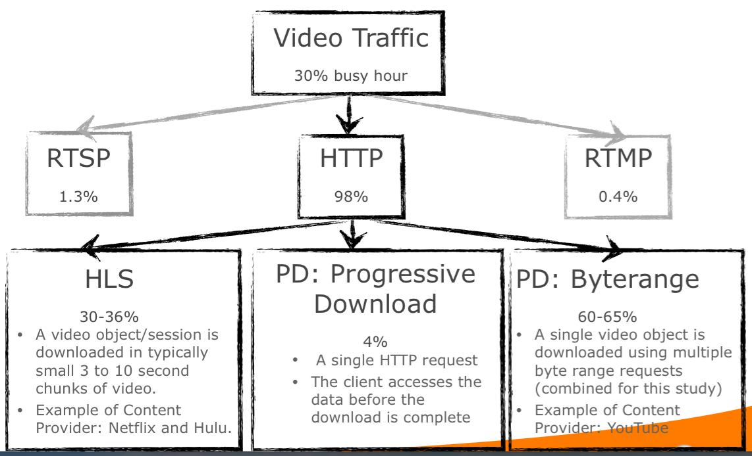
Example of HTTP Streaming Protocols
Apple HLS: HTTP Live Streaming
Microsoft IIS Smooth Streaming: part of Silverlight
Adobe HDS: HTTP Dynamic Streaming
DASH: Dynamic Adaptive Streaming over HTTP

Slide 32
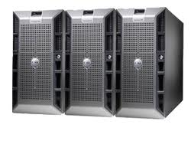
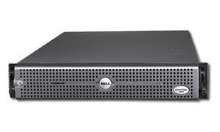
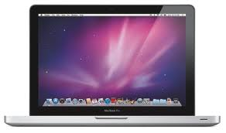
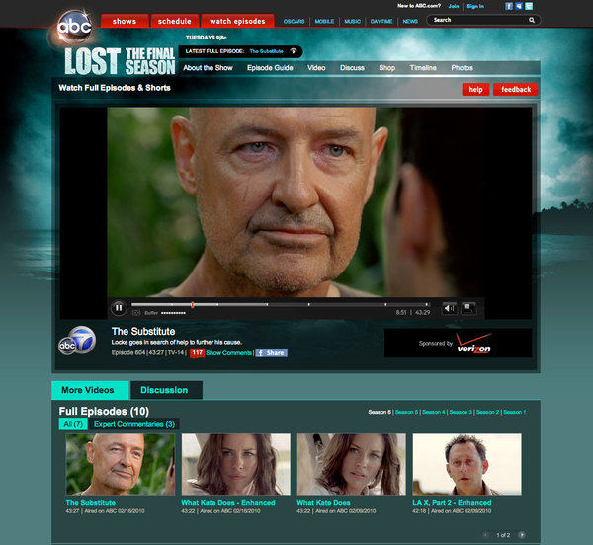

Smooth Streaming
.ISM
.ISMC
Server & Client Manifest files
5Mbps.MP4
CharlieBitMe_10Mbps.MP4
1Mbps.MP4
Mezzanine file
Encoders
500
IIS Server with Smooth Streaming Extension
Fetch Client Manifest File
HTTP GET http://video.foo.com/CharlieBiteMe.ism/QualityLevels(500000)/Fragments(video=0)
HTTP GET http://video.foo.com/CharlieBiteMe.ism/QualityLevels(1000000)/Fragments(video=300000)
Notes:
.ismc
Describes the available streams to the client: the codecs used, bit rates encoded, video resolutions, markers, captions, etc.
It's the first file delivered to the client
The first thing a player client requests from the Smooth Streaming server is the *.ismc client manifest. The manifest tells it which codecs were used to compress the content (so that the client runtime can initialize the correct decoder and build the playback pipeline), which bit rates and resolutions are available, and a list of the available chunks (with either their start times or durations).
With IIS Smooth Streaming, clients request fragments in the form of a RESTful URL: • http://video.foo.com/NBA.ism/QualityLevels(400000)/Fragments(video=610275114)The values passed in the URL represent encoded bit rate (400000) and the fragment start offset (610275114) expressed in an agreed-upon time unit (usually 100 nanoseconds (ns)). These values are known from the client manifest.After receiving the client request, IIS Smooth Streaming looks up the quality level (bit rate) in the corresponding *.ism server manifest and maps it to a physical *.ismv or *.isma file on disk. It then reads the appropriate MP4 file, and based on its 'tfra' index box, figures out which fragment box ('moof' + 'mdat') corresponds to the requested start time offset. It then extracts the fragment box and sends it over the wire to the client as a standalone file. This is a particularly important part of the overall design because the sent fragment/file can now be automatically cached further down the network, potentially saving the origin server from sending the same fragment/file again to another client that requests the same RESTful URL.

Slide 33
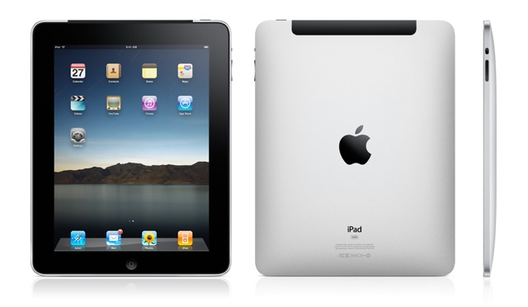
HTTP Live Streaming (HLS)
Stream Segmenters
Per-bitrate.ts media segment files & playlists
5Mbps.MP4
.m3u8
CharlieBitMe_10Mbps.MP4
1Mbps.MP4
.m3u8
Mezzanine file
Encoders
500
.m3u8
.m3u8
Master Playlist
Fetch master play list
Web Server
Fetch bitrate specific playlist
HTTP GET http://media.example.com/segment0.ts
Notes:
Vanilla HLS example
.ts media segment files
.m3u8 play lists
FMS4.5 server supports HLS like smoothstreaming – chunks files on demand.

Slide 34

HTTP Dynamic Streaming (HDS)
f4f Packager
Per-bitrate.f4f segment & .f4m manifest files
5Mbps.MP4
.f4m
CharlieBitMe_10Mbps.MP4
1Mbps.MP4
.f4m
Mezzanine file
Encoders
500
.f4m
Apache with Adobe HTTP Origin module
HTTP GET http://www.example.com/media/CharlieBitMe.f4m
HTTP GET http://www.example.com/media/http_dynamic_StreamingSeg1-Frag1
Notes:
http://help.adobe.com/en_US/HTTPStreaming/1.0/Using/httpdynamicstreaming_help.pdf
.f4fx index files = Location of specific fragments within the segment file
The client sends an HTTP request for media to Apache, for example: http://www.example.com/media/http_dynamic_Streaming.f4m2Apache passes the request to the HTTP Origin Module.3The HTTP Origin Module returns the F4M file to the client.4The client receives the F4M file and uses the bootstrap information to translate time code into a segment#/fragment# pair.5The client sends a second HTTP request to Apache and asks for a specific fragment from the F4F file, for example: http://www.example.com/media/http_dynamic_StreamingSeg1-Frag16Apache receives the request and passes the request to the HTTP Origin Module.7The HTTP Origin Module uses the index file (F4X) to translate the request into a byte offset in the F4F file. It sends the contents of this file that correspond to Segment1 and Fragment. This partial content is an F4F fragment, for example:http://www.example.com/media/http_dynamic_StreamingSeg1.f4f8The client receives the fragment and starts playback based on the bootstrap information provided with the fragment and the information from the F4M file.

Slide 35
Part 1 Outline
Three periods of Internet video evolution
Evolution of video delivery protocols
Today’s end-to-end video eco-system

Slide 36



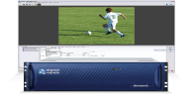
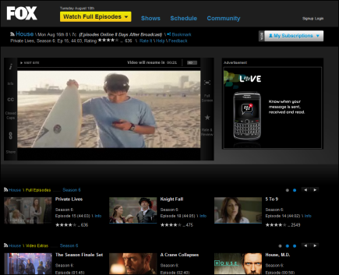
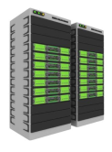
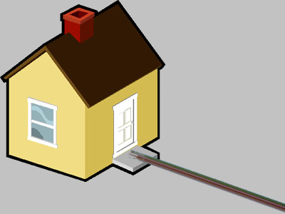



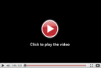
Internet Video Data-plane
Video Source
Screen
Encoders & Video Servers
Video Player
ISP & Home Net
CMS and Hosting
Content Delivery Networks (CDN)

Slide 37
E2E Workflow: Publisher Perspective
Mezzanine file creation
High resolution file creation using commercial video editing tools
Content and metadata management
Metadata associated with content
Content preparation
Prepare content with required renditions and formats
Origin storage
Delivery (CDN and Protocol)
Video Player
Content published into a CMS
Upload to origin(s)
Store content for use by CDNs
Deliver content to the audience
Access, stream, and display content to the audience
Use either one multi-CDN origin or multiple CDN collocated origins
Scale to the audience size as needed

Slide 38

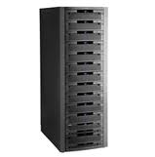


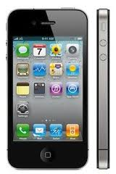


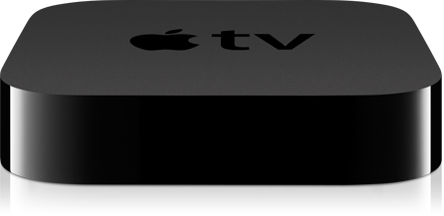
E2E Workflow: Publisher Perspective
VoD Mezzanine file
Content Management System
Progressive Download
RTMPE
HLS
Encoders
Packagers
Smooth Streaming
CDN
HLS
Live Stream
Notes:
* ignored the ad related components, can be easily added.
*

Slide 39
More Complexity with Security
VoD Mezzanine file
Content Management System
Progressive Download
RTMPE
HLS
Encoders
Packagers
+ Encryption
Smooth Streaming
CDN
HLS
License Servers
Live Stream
+ Decryption
Notes:
* ignored the ad related components, can be easily added.
*

Slide 40


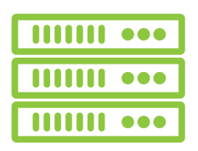



A Simplified Model of Video Advertisement Workflow
Ad Content
Targeting &
Validation
Partners
Ad Proxies
3rd Party CDN’s
Campaign
Management
Systems
3rd Party Ad Networks
Content Delivery Networks (CDN)

Slide 41
State of Internet Video and Implications for Researchers

Slide 42

Video Traffic Is Dominating Internet Traffic
66% Internet Traffic is Video

Slide 43
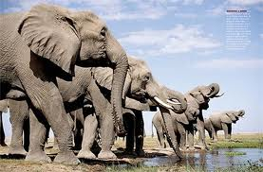
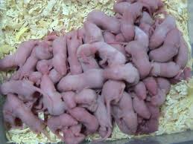
The Video Internet: A World Full of Elephants
What Does It Mean For the Internet
If 95% Traffic is Video?
Video (100x traffic growth)
Other Applications (10 x traffic growth)
2011
2016

Slide 44
What We Have Learned So Far? (1)
1990 Internet
Video & Web Internet
Web Internet
The detour to Web Internet has a key positive legacy
HTTP chunk will be the new Datagram for Internet video
HTTP chunk switches are the new switches/CDN servers
Many practical problems solved for HTTP after years of evolution
Middle-box support, authentication, firewall penetration, anycast

Slide 45
What Have We Learned So Far (2) ?
No universal QoS support inside the network
CDN a key architectural component to optimize performance
DNS-based names are standard control service access interface
HTTP is standard data plane plane protocol

Slide 46

What We Have Learned So Far (3)?
Adaptive multi-bit-rate video key to address diversity
CDN
ISP
GEO
Device
1.2 Mbps
750 Kbps
3 Mbps
1.2 Mbps
750 Kbps

Slide 47
What Have We Learned (4)?
Consumer devices, software architecture, and video applications critical in shaping delivery architecture
Latency with seconds or 10s of seconds allow sophisticated algorithms to be implemented at multiple locations in the end-to-end delivery pipeline
Client machines
CDN edge nodes
Proxy servers inside ISP networks
Security servers
Ad servers
Other data plane or control plane proxy servers

Slide 48
Rest of Tutorial
Focus on latest research on Internet video quality
Importance driven by multiple trends
lean forward experience → lean back experience
short form → long form
free content → paid and premium content
low resolution → high resolution
Part 2: new understanding of video quality metric
enabled by new data source: detailed & comprehensive client-side measurement
Data analysis techniques useful in this context
Part 3: latest research on improving video quality
new problem formulations in the context of today’s Internet video ecosystem

